Slide 1
Progressive Pose Attention Transfer for Person Image Generation
CVPR 2019
Zhen Zhu, Tengteng Huang
Baoguang Shi, Miao Yu
Bofei Wang, Xiang Bai1
Huazhong University
Microsoft, Redmond
ZTE Corporation
https://arxiv.org/abs/1904.03349
梁天保

Slide 2
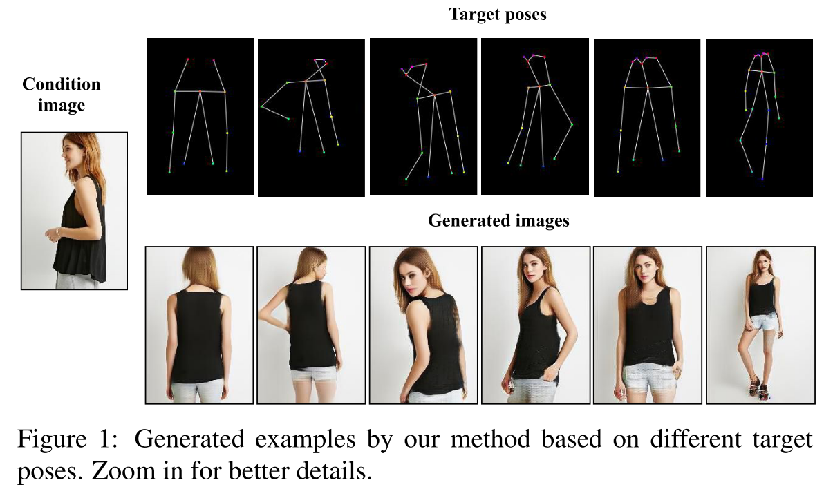
Task
https://arxiv.org/abs/1904.03349

Slide 3
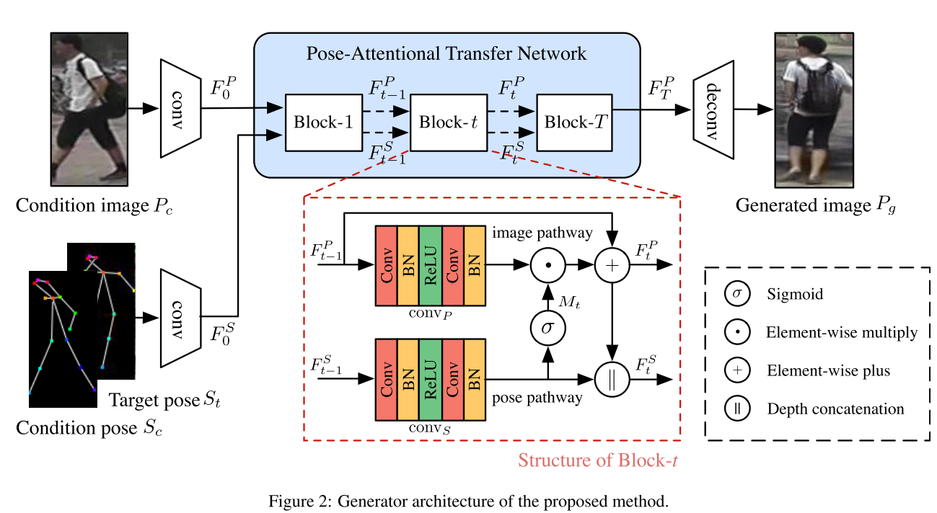


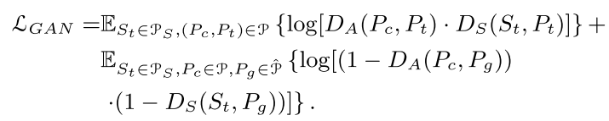



Method
https://arxiv.org/abs/1904.03349

Slide 4
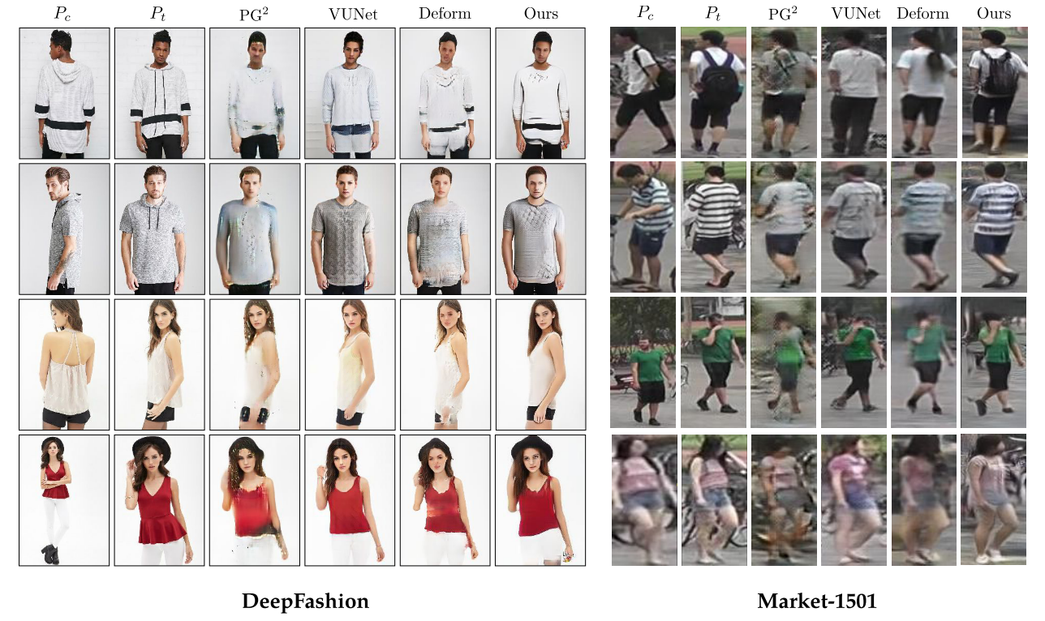
Experiments
Datasets : Market-1501, DeepFashion
https://arxiv.org/abs/1904.03349

Slide 5
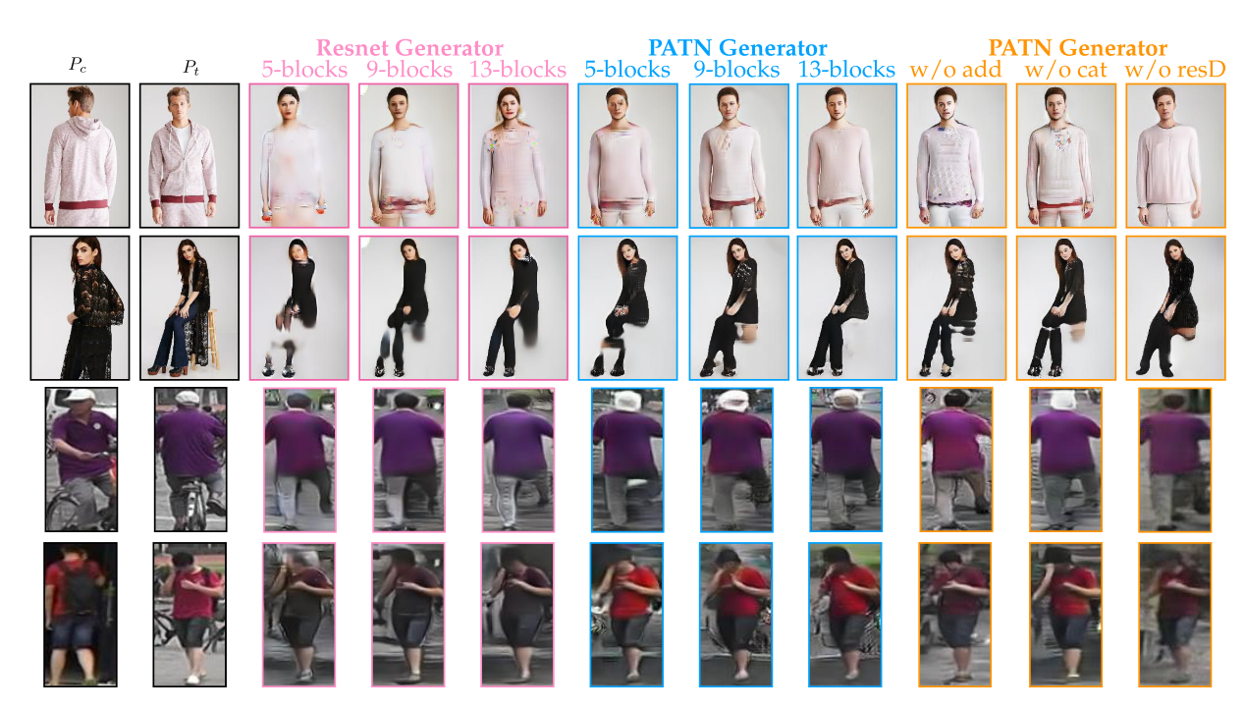
Experiments
https://arxiv.org/abs/1904.03349

Slide 6
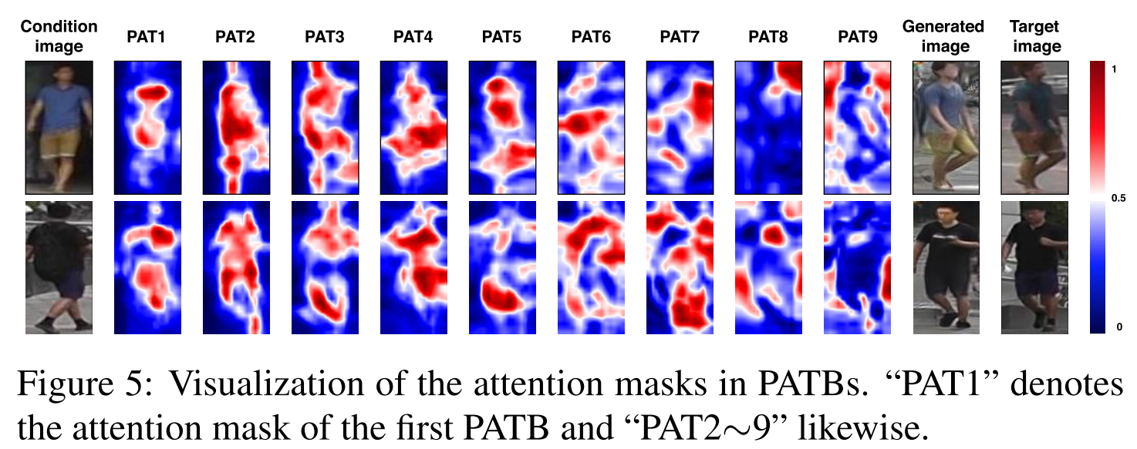
Experiments
https://arxiv.org/abs/1904.03349

Slide 7
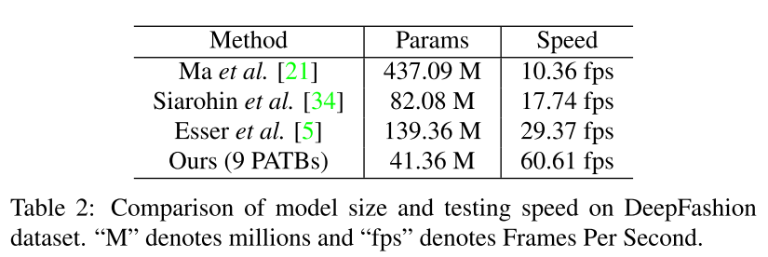
Experiments
https://arxiv.org/abs/1904.03349

Slide 8
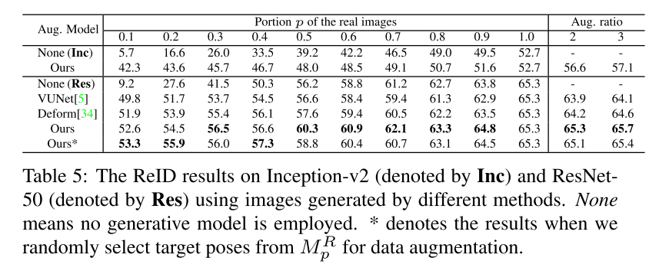
Experiments
https://arxiv.org/abs/1904.03349

Slide 9
Thanks
https://arxiv.org/abs/1904.03349

